Slide 1
Linear Algebra
线性代数
Zongbin Chen YMSC, Tsinghua University
陈宗彬 清华大学数学科学中心
Email: zbchen@tsinghua.edu.can

Slide 2



Change of basis (基变换)
Recall that a finite dimensional vector space $V$ has bases, and using the coordinates with respect to a chosen basis, $V$ is isomorphic to $R^{n}$ with $n=dim(V)$.
Question: Given two bases $B=\{b_{1},⋯,b_{n}\}$ and $C=\{c_{1},⋯,c_{n}\}$, how to pass between the coordinate system with respect to the bases $B$ and $C$?In other words, for any vector $v∈V$, what is the relation between $[v]_{B}$ and $[v]_{C}$?
Advantage: Linear transformations take simpler form with respect to certain well-chosen basis.

Slide 3
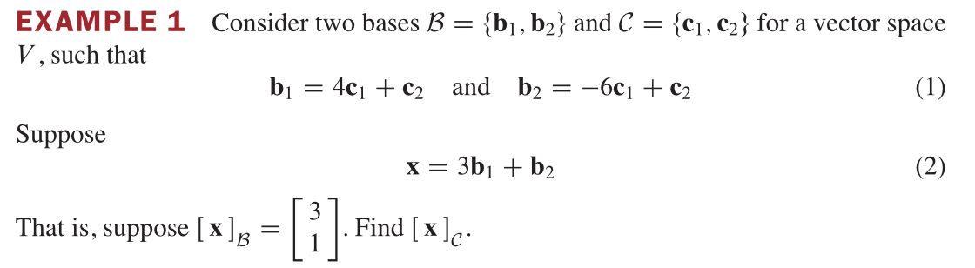

Slide 5
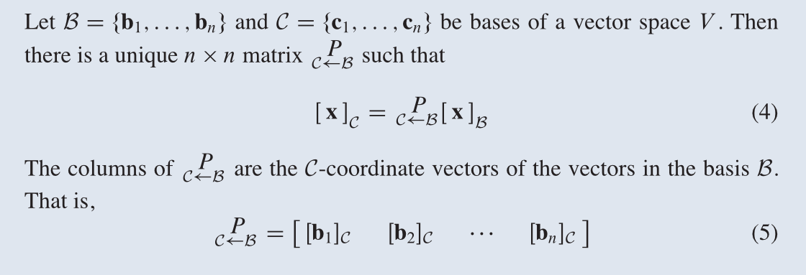
Theorem

Slide 8
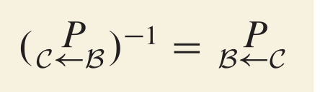
The matrix $P_{B→C}$ is called the transition matrix (转换矩阵) from $B$ to $C$.
Corollary:

Slide 9
Change of basis for $R^{n}$
Theorem: Let $B=\{b_{1},⋯,b_{n}\}$ and $C=\{c_{1},⋯,c_{n}\}$ be two bases of $R^{n}$, let $B=[b_{1}⋯b_{n}]$ and $C=[c_{1}⋯c_{n}]$, then the transition matrix from $B$ to $C$ is $P_{B→C}=C^{-1}B$.

Slide 10
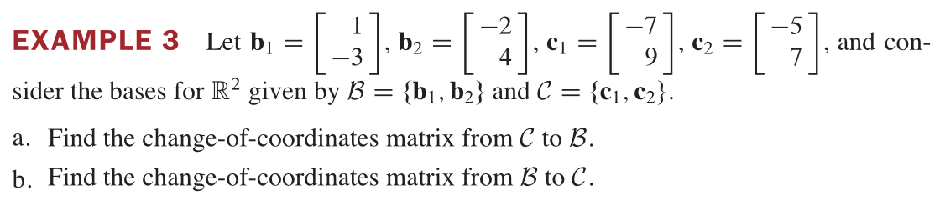
To calculate $C^{-1}B$, recall that we can perform elementary row operations such that $[C∣B]∼[I_{n}∣C^{-1}B]$. That gives an algorithm to calculate the transition matrix $P_{B→C}$.

Slide 12
In particular, let $E=\{e_{1},⋯,e_{n}\}$ be the standard basis, let $B=\{b_{1},⋯,b_{n}\}$ be another basis, and let $B=[b_{1}⋯b_{n}]$, then for any vector $x∈R^{n}$, we have $[x]_{B}=B^{-1}x$. Conversely, $x=B⋅[x]_{B}$.
Indeed, the transition matrix from $E$ to $B$ is $P_{E→B}=B^{-1}I_{n}=B^{-1}$.

Slide 13
Linear transformation under change of basis
Let $f:V→W$ be a linear transformation between finite dimensional vector spaces. Recall that if we pick basis for $V$ and $W$, the linear transformation can be expressed as matrix multiplication $A:R^{n}→R^{m}$, with $n=dim(V),m=dim(W)$.
Question: When we pick another bases for $V$ and $W$, how does $A$ changes?

Slide 14
Theorem: Let $f:V→W$ be a linear transformation between finite dimensional vector spaces. Let $B=\{b_{1},⋯,b_{n}\}$ and $C=\{c_{1},⋯,c_{m}\}$ be basis of $V$ and $W$ respectively, suppose that $f$ is given by the matrix multiplication $A:R^{n}→R^{m}$. Pick another set of basis $B^{′}=\{b_{1}^{′},⋯,b_{n}^{′}\}$ and $C^{′}=\{c_{1}^{′},⋯,c_{m}^{′}\}$ for $V$ and $W$, let $P=P_{B→B^{′}},Q=P_{C→C^{′}}$. With respect to the new basis, the matrix for $f$ equals $A^{′}=QAP^{-1}$.

Slide 16
Corollary: Let $A$ be an $n×n$ matrix, it defines an endomorphism (自同态) $f:R^{n}→R^{n}$ sending $x$ to $Ax$. Let $B=\{b_{1},⋯,b_{n}\}$ be another basis of $R^{n}$, let $B=[b_{1}⋯b_{n}]$, then with respect to the new basis, the matrix for $f$ is $A^{′}=B^{-1}AB$.
Proof: Because $P_{E→B}=B^{-1}$.
Definition: Let $A,A^{′}$ be two $n×n$ matrices, they are said to be conjugate (共轭) or similar (相似), if there exists an invertible $n×n$ matrix $B$ such that $A^{′}=BAB^{-1}$.
In other words, the conjugation matrices describe the same linear transformation, but with respect to different basis.

Slide 17
Example: Let $b_{1}=\left[\begin{aligned}5 \\ 2\end{aligned}\right]$, $b_{2}=\left[\begin{aligned}7 \\ 3\end{aligned}\right]$ be vectors in $R^{2}$. Let $f:R^{2}→R^{2}$ be the linear transformation such that
$f(b_{1})=2b_{1},f(b_{2})=-3b_{2}$.
Then the matrix for $f$ with respect to the basis $b_{1},b_{2}$ is $\left[\begin{matrix}2 & & \\ & & -3\end{matrix}\right]$. What is the matrix with respect to the standard basis?

Slide 18
The example shows that, under a suitable basis, the linear transformation can take on a very simple form.
Question: Let $f:V→V$ be an endomorphism of finite dimensional basis, is it possible to choose a favorable basis of $V$ such that the corresponding matrix is in simpler form?
In other words, given a $n×n$ matrix A, is it possible to conjugate $A$ such that $BAB^{-1}$ is in simpler form?
Yes, can always put it in Jordan form. (To explain later).

Slide 19
Homework
Lay-Lay-McDonald, chapter 4, 4.7 exercises, question 13, 19, 20(a).

Slide 20
Next time
Determinant. Please starting reading chapter 3 of [Lay-Lay-McDonald] or chapter 5 of [Strang].

